Slide 1
How to use this briefing:
Use these slides to introduce your co-workers to the CFC in a virtual or in-person meeting. (Remember to delete this slide before your meeting!)
The suggested script is provided in the notes section of each slide.
Practice giving this presentation until you feel comfortable with the material.
Reach out to a CFC staff member if you have any questions or need any help.
Notes:
Delete this slide before using this presentation.

Slide 2

Welcome to the 2024 CFC!
Sept 1, 2024 – Jan 15, 2025
Notes:
Hi everyone. My name is [introduce yourself]. I am serving as the Combined Federal Campaign (CFC) point of contact this year. Thank you for giving me a few minutes to talk with you about the campaign.

Slide 3



The CFC is…
60+ years
of Federal tradition and generosity.
5,000 charities
depend
on CFC funding
each year.
$8.7 billion
One of the largest workplace giving campaigns in the world.
Notes:
First, let’s make sure we are all on the same page about what the CFC is. The CFC is the annual workplace giving campaign for Federal employees and retirees. It was established by President Kennedy in the 1960s as a cost-effective, efficient, and successful way for the Federal community to make charitable contributions to the nearly 5,000 charities that participate in the CFC each year. All of these charities count on this funding! Since that time, more than $8.7 billion has been raised to help people and communities in need!

Slide 4
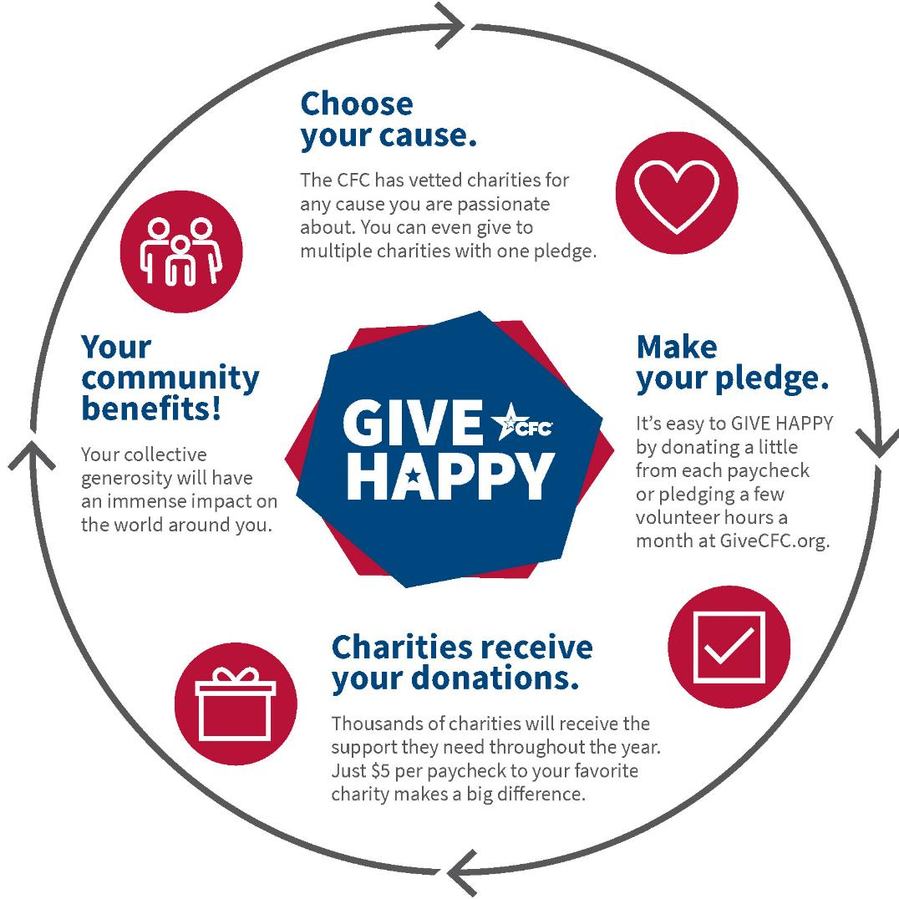
How the CFC Works
How the
CFC works:
Notes:
Here’s how the CFC works. First, you choose a cause that is important to you. Whether that’s medical research, supporting military members and their families, or funding kids’ sports programs in your community, the CFC has vetted charities for any cause you are passionate about. You can use the online charity search or the PDF charity list booklet to select your charities.
Next, you make your pledge. You can use the online giving system, a paper pledge form, the CFC Giving app, or the text-to-donate program. One of the best things about the CFC is the ability to give by payroll deduction. You can also pledge volunteer hours.
Then, your charities receive your donations throughout the year. Just $5 per paycheck makes a big difference. And collectively all of our donations add up to millions and millions of dollars.
These generous dollars flow into your community, across the nation and around the globe – making our world a better and happier place. You never know when one of the CFC participating charities will be able to help you or a loved one, forming a complete circle.

Slide 5

What’s your impact?
Notes:
This year, you are going to see lots of materials talking about the impact you can have when you GIVE HAPPY through the CFC. The CFC highlights 14 different cause areas this year to show all the ways giving through the CFC can impact communities across the nation and around the world.

Slide 6


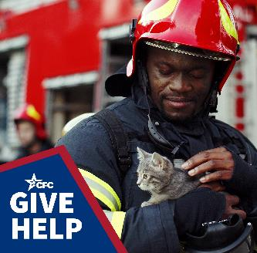












Fourteen Cause to Choose From for 2024
Notes:
Here's what some of the visual representations of what those cause areas look like. The CFC has so many great charities - no matter which cause you want to support.

Slide 7

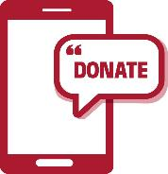
4 Ways to Give
Want the full range of giving options?
Online Giving System: Visit GiveCFC.org and then click DONATE.
Don’t have access to technology at work?
Paper Pledge Form: Ask us about getting a supply.
Want to use your mobile device?
CFC Giving App: Search for “CFC Giving” to download the app.
Want to make the quickest, onetime gift?
Text-to-Donate
Notes:
Now that you know all the awesome causes you can support, let me tell you about HOW you can give through the CFC. There are four ways to pledge; all methods are easy, safe, and secure ways to give through the CFC! It all depends on how someone likes to pledge.
Do you want the full range of giving options? Including giving via payroll deduction, credit card, bank transfer, or even PayPal? Then, the CFC’s most popular giving method, the online giving system, is for you! All you have to do is visit GiveCFC.org and click the DONATE button (it’s right at the top of the page!) to log in to or create an account and get started. One important thing to note is that the CFC’s online giving system is now protected by multi-factor authentication, which means that visitors must have or create a login.gov account before you can access the CFC’s Online Giving System.
But, maybe you work for an agency or office that doesn’t have ready access to technology at work. This includes TSA agents, some members of the military, border patrol officers, USPS mail carriers, and more. In this case, the traditional Paper Pledge Form is for you. We have some printed pledge forms available for campaign workers in these types of agencies to distribute. If you have access to the website, you can also print them off yourself.
Take giving on the go with the CFC mobile app. If you love using your phone – you can easily download the CFC Giving Mobile App by searching for “CFC Giving” on your iPhone or Android device mobile stores and get started.
And finally, if you want to make the quickest, onetime gift, then you can use the CFC’s Text-to-Donate program. (These instructions need to be finalized and added before training starts.) One caveat to using this method is that our unit will not get credit for your donation as there is no way to designate your unit in this quick and easy pledge method. However, this is still a great introduction to the CFC and a great option for someone who wants to make a quick pledge.

Slide 8


Volunteer Hours
Pledge volunteer hours as an individual.
Online donors can record volunteer hours fulfilled throughout the year.
Pledge group volunteer activities.
Monetized volunteer hours are added to fundraising totals.
Charities accepting volunteer hours will be designated with a hand icon in the charity listing.
Notes:
Another benefit of the CFC is that Federal employees can also pledge volunteer hours to charities that accept them. You will know which charities accept them by looking for the hand icon next to the charity in the Charity List. Charities will often have in person and virtual volunteer opportunities. And now, donors who pledged via the Online Giving System can record the hours they have fulfilled through out the year.
You can even record group volunteer activities through the CFC’s Online Giving System. Planning a group volunteer activity is a great team-building exercise, a wonderful way to promote the CFC, and exposes your colleagues to the amazing work CFC charities do in your community. You will need to work within your agency guidelines when planning a group volunteer project. You will also need to work with your OC to assure the fair and equitable selection of a charity with which to volunteer.
And just a note, the CFC values the volunteer hours pledged and those dollars are added to the fundraising totals for each office/unit/agency. So that can be a nice bump for your campaign totals.

Slide 9
Support Our Fundraising Goals
When you GIVE HAPPY, you will need your:
Office ZIP code:______________________
CFC Unit code: _______________________
Put your ZIP code here
Put your CFC Unit code here
Notes:
One of the benefits of giving through the CFC is that you get to be a part of the CFC community and support our installation/unit/agency/office fundraising goal. In order to ensure that your office/unit receives “credit” for your donations is to use the correct “CFC unit code” (a special 6-digit number assigned to your unit) and “ZIP code” (this needs to be the ZIP code of your LOCAL office, not your home). When you give online, using a paper pledge form, or via the mobile app you will have the opportunity to enter these important identifiers. [If your agency/installation HAS a dollar goal, please feel free to mention it here.]

Slide 10

The CFC needs YOU!
Just $5 per paycheck makes a huge impact.
Notes:
The CFC needs you. It needs all of us, actually. It’s amazing to see how giving a little out of each paycheck or a few hours a month adds up to so much happiness when we give together. We are changing the world one donation at a time. Here’s just one example of how CFC participating charities benefit from our donations: [choose one of the following stories to tell]
Option 1:
Throughout his career, Aro, a working dog for the U.S. Border Patrol, received many awards for his role in hundreds of confiscations of illegal drugs and thousands of apprehended suspects. After retiring from his illustrious career, Aro suffered a ruptured mass in his digestive tract. Fortunately, one of the CFC participating organizations believes officers/handlers/owners should not have to shoulder the burden of large veterinary bills for their retired canine partners. They stepped in and covered the cost of Aro’s emergency surgery. Now Aro can live the rest of his life in comfort with the family who loves him.
Option 2:
Cash, a six-year-old with cerebral palsy, was unable to stand, crawl, walk, or even sit for extended periods of time without assistance. That is, until his mom found a CFC-participating organization in their local community that offered therapeutic riding programs for kids like Cash. When he first started riding, Cash needed an instructor to sit with him on the horse to keep him safely balanced, but over time, he started riding on his own. With each ride, he gains core strength and stamina. He also loves the bond he has with the horse he rides, Justin.
Option 3:
Michael, a young cow herder in South Africa, saw education as his pathway out of poverty. Although he didn’t start kindergarten until he was 15, he finished his education and became a construction manager. Now, he partners with a CFC-participating organization to build classrooms for students who would otherwise have to learn outdoors and for whom learning would have to stop during the rainy season. The classrooms he builds go beyond helping to educate the youth in his community. Some are used at night for adult learning or as makeshift dormitories for girls in areas where exceptionally long walks home after dark would be dangerous.
Option 4:
Grocery bills have been increasing for many families across the country, making it more difficult to put food on the table. For most of us, this is inconvenient, but for many families, this is an insurmountable obstacle. One CFC-participating charity provides “blessing bags” filled with food to school-aged children in their local community. The number of students needing weekend food has increased from 100 to nearly 850, showing the great need for food and assistance during these challenging times. During each distribution, at least five kids ask to be added to the program because of this need.
Option 5:
Michael, a married father of four, has spent a large portion of his life serving our country, first in the Marine Corps, then in the Army, and finally in the Army National Guard. He was serving in Iraq when his group came under enemy fire and he was blown from his truck, hitting his head on a rock. He medically retired from military service with a 100% disability rating. He returned home to find his family facing homelessness after being evicted from their rental. Michael turned to a CFC-participating organization staffed by veterans who assist other veterans. The organization gave the family a grant to cover their hotel costs while they found a suitable home. Michael says the organization was a blessing in his family’s time of need.

Slide 11
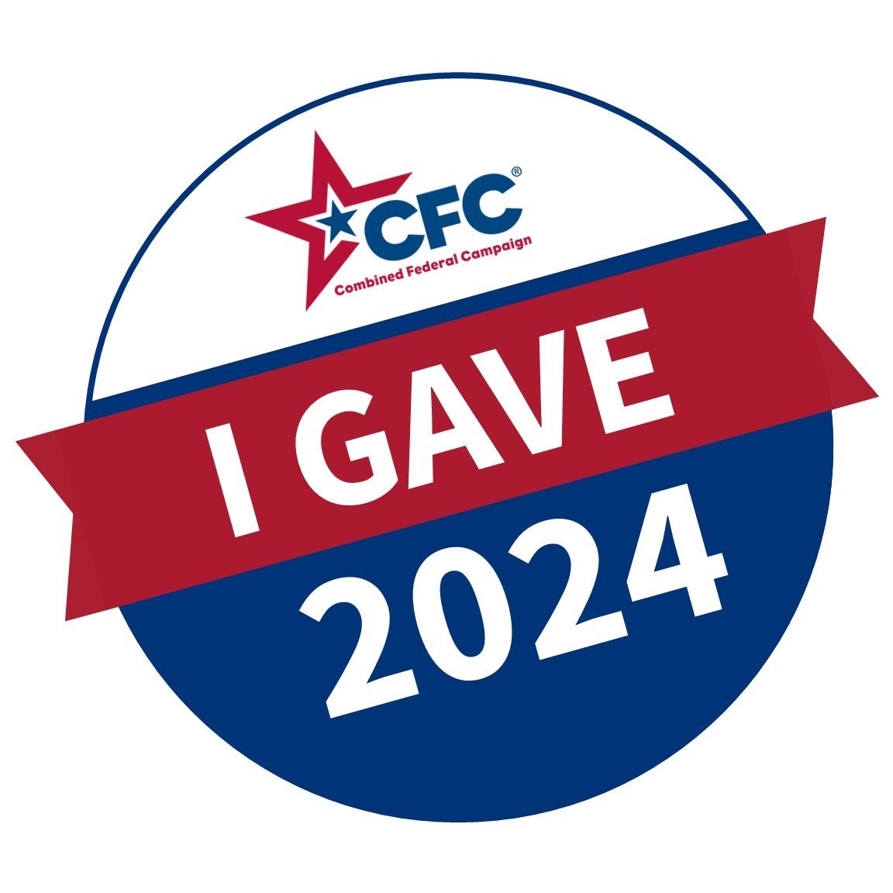
Visit GiveCFC.org to get started.
What’s your impact?
Notes:
And so, I ask each of you to join me in taking a few moments to give through the CFC this year. What will your impact be?
Thank you for letting me talk about the CFC with you today. You will be hearing from me via email each week to share information, progress updates, and more stories about how your donations will help people in need. Please let me know if you have any questions I can answer.

