Slide 1

Welcome to the 2024 CFC!
Notes:
Welcome to the 2024 Combined Federal Campaign, also known as the “CFC.” [Introduce yourself.]
Thank you for attending today’s Campaign Worker Training session. I am so glad you are here. During the next hour, I am going to show you how by inviting your co-workers to join the CFC, you will have a huge positive impact on the world around you.

Slide 2



The CFC is…
60+ years
Of Federal tradition and generosity
5,000 charities
Depend
on CFC funding
each year
$8.7 billion
One of the largest workplace giving campaigns in the world
Notes:
First, let’s make sure we are all on the same page about what the CFC is. The CFC is the annual workplace giving campaign for Federal employees and retirees. It was established by President Kennedy in the 1960s as a cost-effective, efficient, and successful way for the Federal community to make charitable contributions to the nearly 5,000 charities that participate in the CFC each year. All of these charities count on this funding! Since that time, more than $8.7 billion has been raised to help people and communities in need!

Slide 3
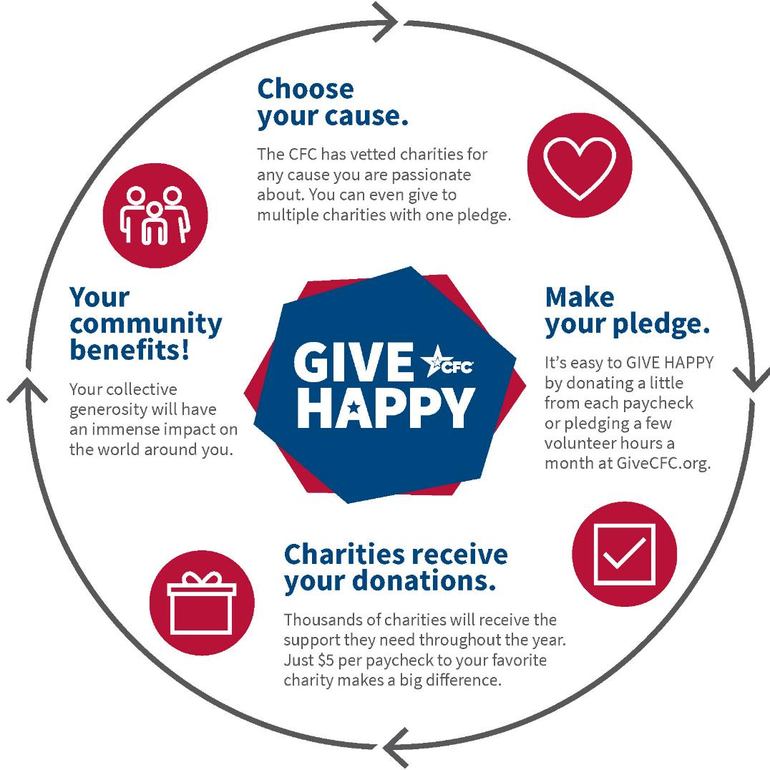
How the
CFC works:
Notes:
Here’s how the CFC works. First, you choose a cause that is important to you. Whether that’s medical research, supporting military members and their families, or funding kids’ sports programs in your community, the CFC has vetted charities for any cause you are passionate about. You can use the online charity search or the PDF charity list booklet to select your charities.
Next, you make your pledge. You can use the online giving system, a paper pledge form, the CFC Giving app, or the text-to-donate program. One of the best things about the CFC is the ability to give by payroll deduction. You can also pledge volunteer hours.
Then, your charities receive your donations throughout the year. Just $5 per paycheck makes a big difference. And collectively all of our donations add up to millions and millions of dollars.
These generous dollars flow into your community, across the nation and around the globe – making our world a better and happier place. You never know when one of the CFC participating charities will be able to help you or a loved one, forming a complete circle.

Slide 4

What’s Your Impact?
Notes:
This year, you are going to see lots of materials talking about the impact you can have when you GIVE HAPPY through the CFC. The CFC highlights 14 different cause areas this year to show all the ways giving through the CFC can impact communities across the nation and around the world.

Slide 5















14 Causes for 2024
Notes:
Here's what some of the visual representations of what those cause areas look like. The CFC has so many great charities - no matter which cause you want to support.

Slide 6
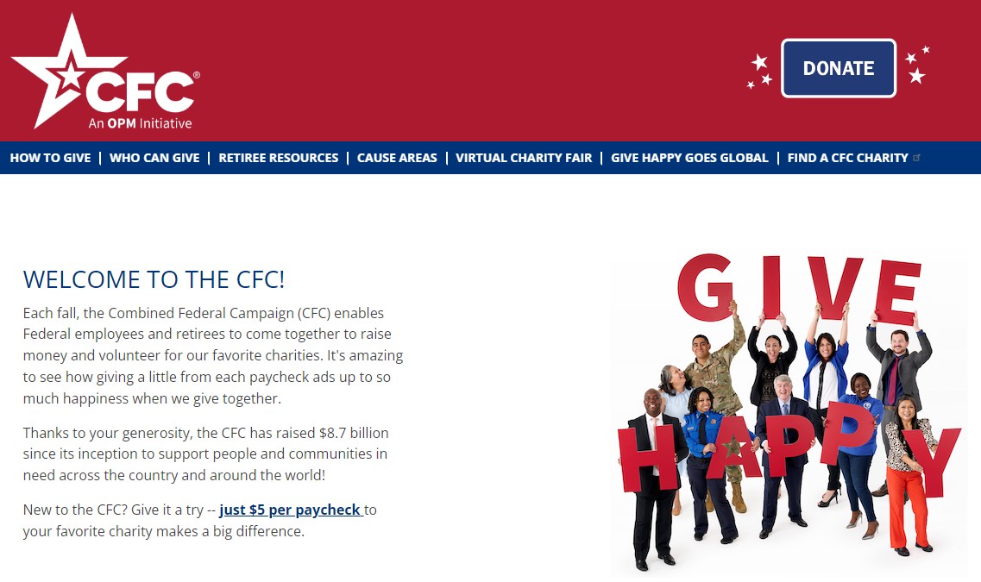
4 Ways to Give – Online System
Want the full range of giving options?
Online Giving System: Visit GiveCFC.org and then click DONATE.
Notes:
Now that you know all the awesome causes you can support, let me tell you about HOW you can give through the CFC. There are four ways to pledge; all methods are easy, safe, and secure ways to give through the CFC! It all depends on how someone likes to pledge.
Do you want the full range of giving options? Including giving via payroll deduction, credit card, bank transfer, or even Paypal? Then, our most popular giving method, the online giving system, is for you! All you have to do is visit GiveCFC.org and click the DONATE button (it’s right at the top of the page!) to log in to or create an account and get started. One important thing to note is that the CFC’s online giving system is now protected by multi-factor authentication, which means that visitors must have or create a login.gov account before you can access the CFC’s Online Giving System.

Slide 7
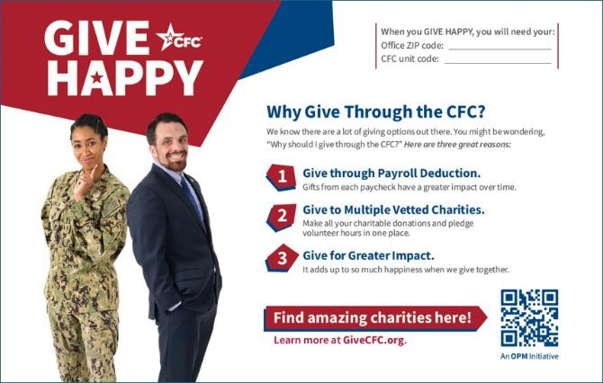
4 Ways to Give – Paper Pledge Form
Want the full range of giving options?
Online Giving System: Visit GiveCFC.org and then click DONATE.
Don’t have access to technology at work?
Paper Pledge Form: Ask us about getting a supply.
Notes:
But, maybe you work for an agency or office that doesn’t have ready access to technology at work. This includes TSA agents, some members of the military, border patrol officers, USPS mail carriers, and more. In this case, the traditional Paper Pledge Form is for you. We have some printed pledge forms available for campaign workers in these types of agencies to distribute. If you have access to the website, you can also print them off yourself.

Slide 8

4 Ways to Give – CFC Giving App
Want the full range of giving options?
Online Giving System: Visit GiveCFC.org and then click DONATE.
Don’t have access to technology at work?
Paper Pledge Form: Ask us about getting a supply.
Want to use your mobile device?
CFC Giving App: Search for “CFC Giving” to download the app.
Notes:
Take giving on the go with the CFC mobile app. If you love using your phone – you can easily download the CFC Giving Mobile App by searching for “CFC Giving” on your iphone or android device mobile stores and get started.

Slide 9
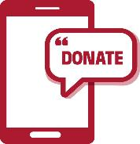
4 Ways to Give – Text to Donate
Want the full range of giving options?
Online Giving System: Visit GiveCFC.org and then click DONATE.
Don’t have access to technology at work?
Paper Pledge Form: Ask us about getting a supply.
Want to use your mobile device?
CFC Giving App: Search for “CFC Giving” to download the app.
Want to make the quickest, onetime gift?
Text-to-Donate
Notes:
And finally, if you want to make the quickest, onetime gift, then you can use the CFC’s Text-to-Donate program.
(These instructions need to be finalized and added before training starts.)
One caveat to using this method is that your unit will not get credit for your donation as there is no way to designate your unit in this quick and easy pledge method. However, this is still a great introduction to the CFC and a great option for someone who wants to make a quick pledge.

Slide 10
Support Your Fundraising Goals
When you GIVE HAPPY, you will need your:
Office ZIP code:______________________
CFC Unit code: _______________________
Notes:
What do I mean by your unit getting credit for your donation? Well, one of the benefits of giving through the CFC is that you get to be a part of the CFC community and support your installation/unit/agency/office fundraising goal. In order to ensure that your organization receives “credit” for the donations of your colleagues is for everyone to use the correct “CFC unit code” (a special 6-digit number assigned to your unit) and “ZIP code” (this needs to be the ZIP code of your LOCAL office, not your home). When you give online, using a paper pledge form, or via the mobile app you will have the opportunity to enter these important identifiers. So be sure your co-workers know what these are!

Slide 11

Volunteer Hours
Pledge volunteer hours as an individual.
Online donors can record volunteer hours fulfilled throughout the year.
Pledge group volunteer activities.
Monetized volunteer hours are added to fundraising totals.
Charities accepting volunteer hours will be designated with a hand icon in the charity listing.
Notes:
Another benefit of the CFC is that Federal employees can also pledge volunteer hours to charities that accept them. You will know which charities accept them by looking for the hand icon next to the charity in the Charity List. Charities will often have in person and virtual volunteer opportunities. And now, donors who pledged via the Online Giving System can record the hours they have fulfilled through out the year.
You can even record group volunteer activities through the CFC’s Online Giving System. Planning a group volunteer activity is a great team-building exercise, a wonderful way to promote the CFC, and exposes your colleagues to the amazing work CFC charities do in your community. You will need to work within your agency guidelines when planning a group volunteer project. You will also need to work with your OC to assure the fair and equitable selection of a charity with which to volunteer.
And just a note, the CFC values the volunteer hours pledged and those dollars are added to the fundraising totals for each office/unit/agency. So that can be a nice bump for your campaign totals.

Slide 12
What does a Campaign Worker do?
Notes:
Ok! Now that you know a little about the CFC and how it works, let’s talk about your role as a campaign worker.

Slide 13
Who are campaign workers?
Campaign Manager/Coordinator | Keyworker
Leads CFC effort - Develops internal campaign plan - Recruit & support Keyworkers | Supports and implements campaign plan - talk with coworkers about CFC
Get overall leadership support - Brief campaign progress | Keep local leaders (supervisors) informed
Notes:
Thousands of campaign workers (like you!) throughout the Federal government make the CFC possible every year. As a campaign worker, you will inspire your colleagues by sharing how they can make an impact through the CFC.
Within each campaign location/agency/office/military installation, there is typically a Campaign Manager/Coordinator who leads the CFC effort. To help implement the CFC, the Campaign Manager/Coordinator recruits a team of Keyworkers. Campaign Manager/Coordinators may also involve people from technology, communications, public affairs, legal, etc. as a part of their internal CFC team.
Typically, Campaign Managers/Coordinators develop a campaign plan, get overarching leadership support, and recruit, inspire, and support a group of Keyworkers.
And typically, Keyworkers are responsible for talking with their assigned group of co-workers about the CFC.
These roles are somewhat fluid. More and more we are seeing Campaign Manager/Coordinator and Keyworkers collaborating on tasks. BUT, the most important thing is:

Slide 14
What’s the ultimate goal?
Invite all of your colleagues to give through the CFC.
Notes:
There is a regulatory requirement to have a CFC in all departments and agencies. And as a campaign worker, you want the CFC to be as successful as possible. Your #1 goal is to invite all of your colleagues to give through the CFC. It really is that simple. This is a voluntary campaign, so whether someone chooses to give and how much they choose to give and which charities they choose to support are very personal decisions. All you have to do is make sure they know about the CFC, know why the CFC is important, know how to give, and have been invited to participate. This entire training will be geared towards helping you accomplish this task.

Slide 15



3 ways to have an outstanding CFC.
Inspire colleagues.
Promote the campaign.
Involve leadership.
Notes:
Now, let’s start to break down how you can achieve that goal of ensuring that all of your co-workers have been invited to give through the CFC. Historical results have shown there are three things you can do as a campaign worker to ensure the success of the CFC at your location. I am going to walk through each of them and provide some examples on how to accomplish each. And this is what I was talking about earlier, Campaign Managers/Coordinators and Keyworkers may partner to accomplish these things.

Slide 16
Inspire Colleagues
Definitely do this.
Send the weekly CFC emails.
Want to do a little more?
Talk about the CFC.
Inspire colleagues.
Go above and beyond.
Plan and host a CFC event.
Notes:
The first is to inspire your colleagues.
The easiest way to do this is by sending a weekly email to your colleagues. The great news is, these are already written for you and ready to use! A little later in the training, I am going to show you were to find these templates. So in this case, maybe Campaign Manager/Coordinators first send the email to Keyworkers and Keyworkers send these emails out to their assigned co-workers.
Another great way to talk about the CFC with your colleagues. The best way to do this is through one-on-once conversations where you can share what your cause is or tell a story about how you or someone you know has been helped by a charity. Alternatively, you use the CFC briefing slides we have prepared to introduce your co-workers to the CFC in a team meeting. Again, this is usually a Keyworker responsibility, but maybe the Campaign Manager/Coordinator conducts a briefing at a staff meeting and then Keyworkers follow up with each of their assigned co-workers. That could be as simple as introducing yourself as the CFC Keyworker, asking if they have any questions about the CFC you can answer, and mentioning a few reasons why giving through the CFC is so great!
If you really want to go above and beyond, plan and host a CFC event. Campaign events can be a lot of fun and are a great way to supplement your campaign. I am going to be talking more about CFC events a little later. But CFC events are a great way for Campaign Managers/Coordinators and their Keyworkers to work together as a team.

Slide 17


3 ways to have an outstanding CFC - Promotion.
Inspire colleagues.
Promote the campaign.
Involve leadership.
Notes:
The second way to have an outstanding CFC is to promote the CFC everywhere you can. This helps keep the CFC top of mind. You’ve introduced your co-workers to the campaign, but people are busy! They need to be reminded “Oh yeah, its CFC time and I still need to make my pledge.” Research has shown that it takes 4-6 touchpoints before someone takes action.

Slide 18



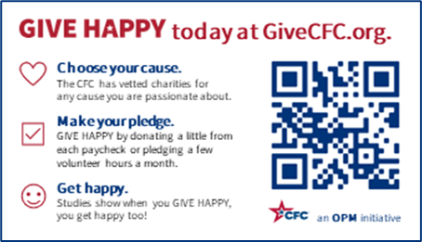
Promote the Campaign
Definitely do this.
Want to do a little more?
Hang posters and flyers.
Distribute HAPPY cards.
Promote the campaign.
Go above and beyond.
Work with Public Affairs/Comms.
Notes:
The easiest way to promote the campaign is by hanging posters and flyers in your workspaces and put digital posters/splashscreens on any monitors or digital screens in your building. The CFC has several choices to choose from. You can use them all together or change them out throughout the campaign. As I mentioned earlier, you can use the Barometer poster to measure your progress from week to week or you can even design your own poster using our template, your agency’s logo and your own photo!
Another great way to promote the campaign is by distributing our business card sized HAPPY cards to your colleagues. We have printed versions of these cards for you or you can print them from our website (GiveCFC.org) and cut them out yourself. These are great tools to use when talking with your co-workers about the CFC. Or you can simply leave them on people’s desks as a reminder. The CFC even has a fun challenge this year called “GIVE HAPPY goes global” where Federal employees and retirees are encouraged to submit a photo of their HAPPY card in their town or with something that represents their favorite cause area. You can find more details about this activity on GiveCFC.org.
If you really want to go above and beyond to promote the campaign, we recommend that you work with your PAO or communications team to post CFC related content on social media, intranet sites, and newsletters. They may even have other great ideas on how they could help promote the campaign. If you need a certain resource or graphic, just let us know!

Slide 19

3 ways to have an outstanding CFC – Leadership.
Inspire colleagues.
Promote the campaign.
Involve leadership.
Notes:
The third way to have an outstanding campaign is to involve your leadership as much as you can. Historically, we have seen that campaigns with visible and tangible support from their leaders have much better results than those that do not. We ALL know that what is important to the boss is important to everyone. So, it makes sense that a great campaign starts with great leadership support. Garnering leadership support is typically a Campaign Manager/Coordinator responsibility, but can also flow down to Keyworkers at the local supervisor level.

Slide 20
Involve Leadership
Definitely do this.
Set a goal and track progress.
Want to do a little more?
Send out messages of support.
Involve leadership.
Go above and beyond.
Participate in a challenge/event.
Notes:
Here are some things you can ask your leaders to do to show their support of the campaign.
The easiest way to get your leaders involved is to have them set a dollar goal for the campaign and then publicly track progress against that goal in staff meetings or other avenues. You can use the Barometer Poster (that you can download from our website GiveCFC.org) to make this really easy.
Another great way for leaders to get involved is by sending out messages of support. Use our prewritten communications templates to send CFC emails or memos or publish articles on intranet sites or newsletters. They can even film a video message. Be sure to share any of these efforts with us so we can amplify the message by posting them on the Leadership Messages page on GiveCFC.org.
And if your leaders really want to go above and beyond, ask them to implement a creative challenge. For example, maybe they agree to take a pie in the face if a certain goal or milestone is attained. If you are planning to host a CFC event, another way your leaders can support is by attending and speaking at that events.

Slide 21
Where can I find tools and resources?
GiveCFC.org
Notes:
Now that you know some ways to have a successful campaign, let’s talk about where you will find all the tools and resources we have for you. All of our tools and resources can be found on our website: GiveCFC.org.
[If you have the ability to show the website and do a live walkthrough on how to navigate resources in your training, do that (and delete the following slides). If you cannot do a live walkthrough of the website, continue using the following slides.]

Slide 22
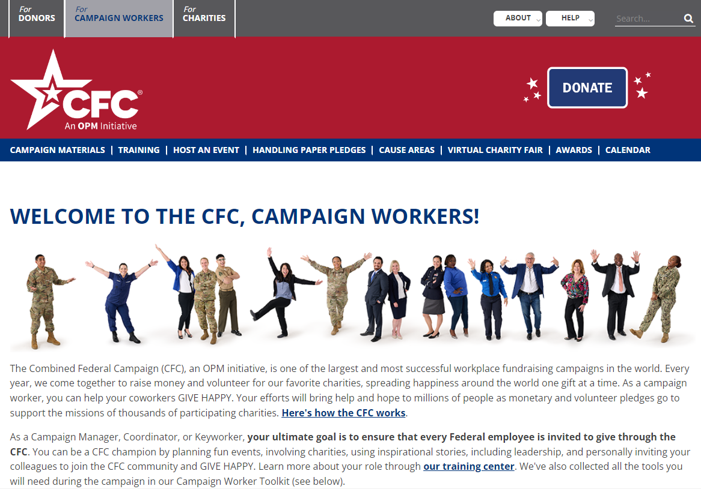
For Campaign Workers Tab
Notes:
When you first get to our website, you will land on the “donor page.” To access information for campaign workers, you will need to click the “For Campaign Workers” tab at the top of the page. From this Campaign Workers page, you can access all of the campaign materials and resources we have talked about. Across the top ribbon in blue, you will see lots of options to visit pages that have campaign materials, campaign worker training, instructions on how to host an event, how to collect and submit paper pledge forms, information on the CFC cause areas, the Virtual Charity Fair, what type of awards we offer, and a calendar of events. If you scroll down on this main page, you will also find our Campaign Worker Toolkit.

Slide 23
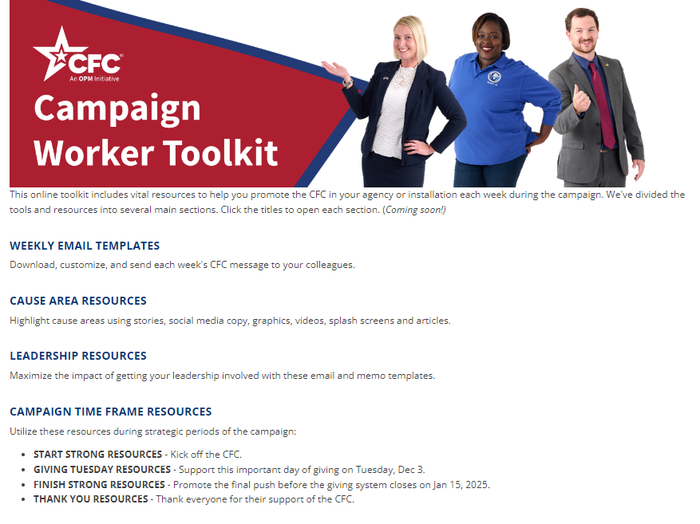
Weekly Email Templates
Notes:
As you can see, this toolkit offers tons of great resources, organized by category. Remember when we talked about some ways to have a great campaign? And one of them was to send a weekly, CFC email to your co-workers?

Slide 24
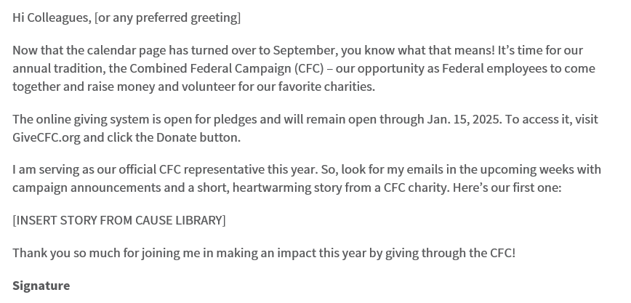
Pre-written Communications
Notes:
Here is what one looks like. Sure, you can customize them, but using these pre-written communications, makes this very easy! You will notice this line “INSERT STORY FROM CAUSE LIBRARY”. You will be able to find a selection of those stories in the CAUSE AREA RESOURCES section of this toolkit. You can choose the one you think will resonate with your co-workers each week and copy and paste it right into the email.

Slide 25
Cause Area Resources
Notes:
Next, let’s talk about those cause area resources. Like I showed you earlier in the presentation, the CFC has 14 cause areas this year. And the toolkit provides not only the stories I just mentioned, but also graphics, videos, splash screens, and more for each cause area. And you can find all of these resources available right here for you to use in social media, newsletters, emails, and intranet sites. We recommend that as part of your campaign plan, Campaign Managers/Coordinators outline when they will promote each cause area. If you are running a campaign from September through January 15, you can choose a cause per week. If you are part of an agency that runs an abbreviated campaign, you might choose to highlight two causes per week. But ensuring that you are talking about and promoting all of the cause areas over the course of your campaign is the best way to inspire your co-workers to give.

Slide 26
Leadership Resources & Time Frames
Notes:
Finally, the toolkit also has pre-written communications your leaders can use and other resources to support strategic points during the campaign like the start strong or kickoff period, Giving Tuesday, Finish Strong and Thank You.

Slide 27
Welcome Campaign Workers
Notes:
Ok. Now that we scrolled down and had a look at the Toolkit, let’s scroll back up on the Campaign Worker page on GiveCFC.org and take a look at a few of the other pages we can link to in this top blue ribbon. The first one is “Campaign Materials.”

Slide 28
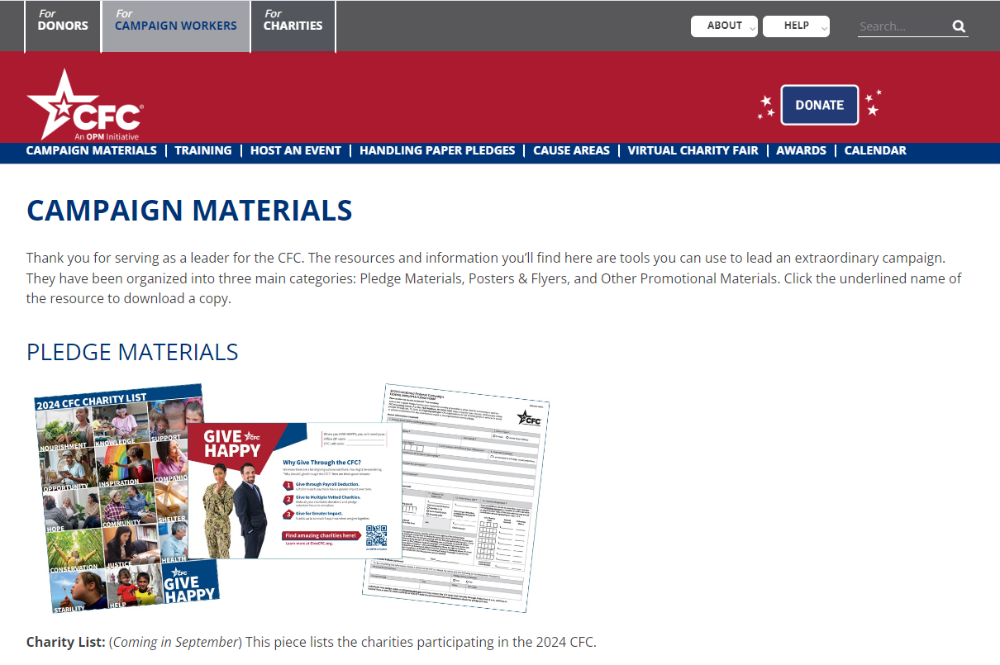

Campaign Materials
Notes:
The campaign materials page is another page full of resources for you to download. These are grouped into:
Pledge materials: which includes the PDF charity list, pledge forms, donor cards, and giving instructions.
Posters & flyers: which includes all kinds of posters you can download and use including the barometer poster used to track campaign progress.
Other promotional materials: the HAPPY card, the CFC briefing slides and the thank you card, for example.
At the bottom of the page are a few other miscellaneous things you might be looking for like the CFC and GIVE HAPPY logos, circle props to use at events, and backgrounds for virtual meetings.

Slide 29
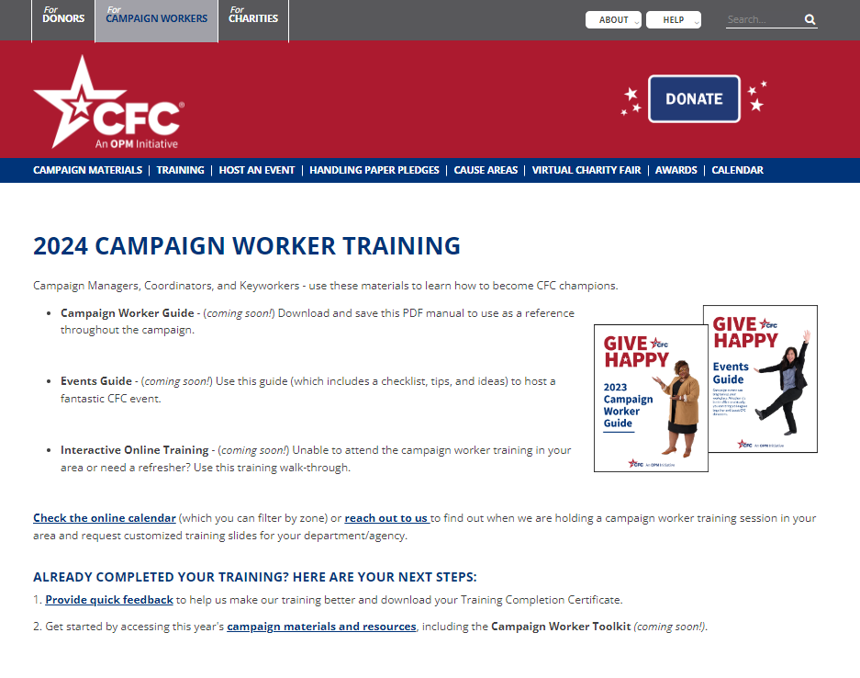

Training Resources
Notes:
Do you feel like we are covering an awful lot today? Well, don’t worry. We do have some resources to help you. Clicking the “Training” link in the blue ribbon will take you to a training resource page. Here will be able to download the Campaign Worker Guide. It has in PDF format all of the information we are coving in today’s training session. Download and save or print this to use as your go-to resource throughout the campaign.
Additionally, you can walk through our Interactive Online Training for campaign workers. This is a great way to refresh your memory on all the things we covered today.
Finally, you can access a quick feedback form about our training at the end of which you can download your Training Completion Certificate.

Slide 30
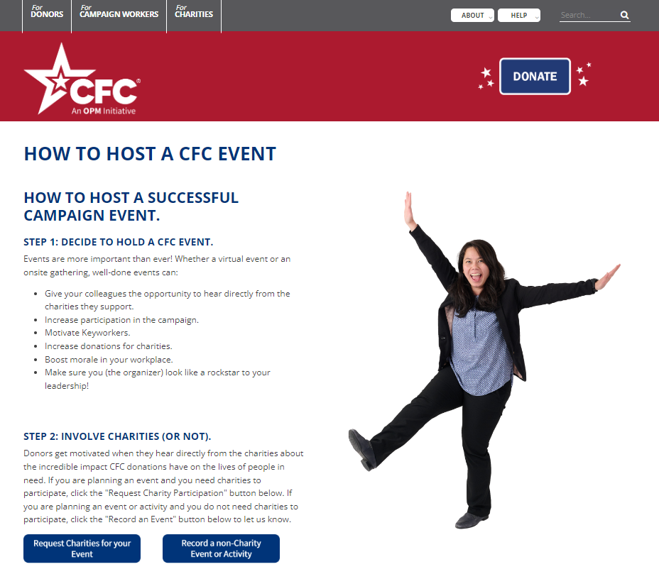
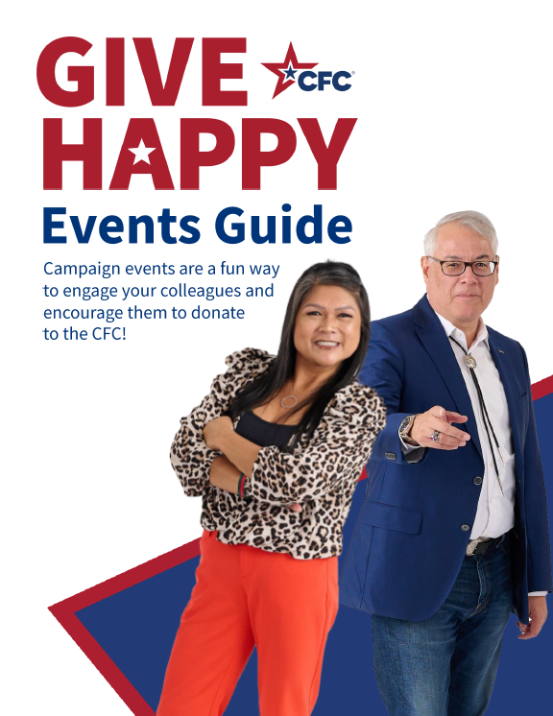
How to Host An Event
Notes:
Next is the “Host an Event” link. Hosting a CFC event can be a really fun way to motivate your co-workers to participate in the campaign. You can see here that having a CFC event has a lot of great benefits such as increasing participation in the campaign which means more donations for charities. It can also be a really great way to boost morale in your workplace and make you look like a rockstar! Inviting charities to participate in your event as speakers or as part of a charity fair can be really inspiring. This webpage has a link to a form where you request charities to participate in your event. To learn more, download the events guide, the tips sheet, and the event video. The Events Guide has a really great checklist of everything you need to consider when planning an event as well as tips and best practices and some of the rules around CFC events.

Slide 31
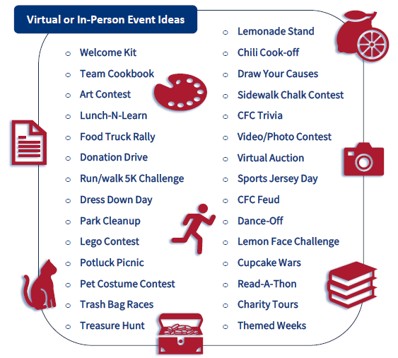
Virtual or In-Person Event Ideas
Notes:
Campaign events are the way to put the FUN back in FUNdraising. Have you ever been to a really fun CFC event? Feel free to call it out or put it in the chat. Some popular ones are chili cookoffs, talent shows, charity fairs, and physical challenges. Here are a few ideas to get you thinking…

Slide 32
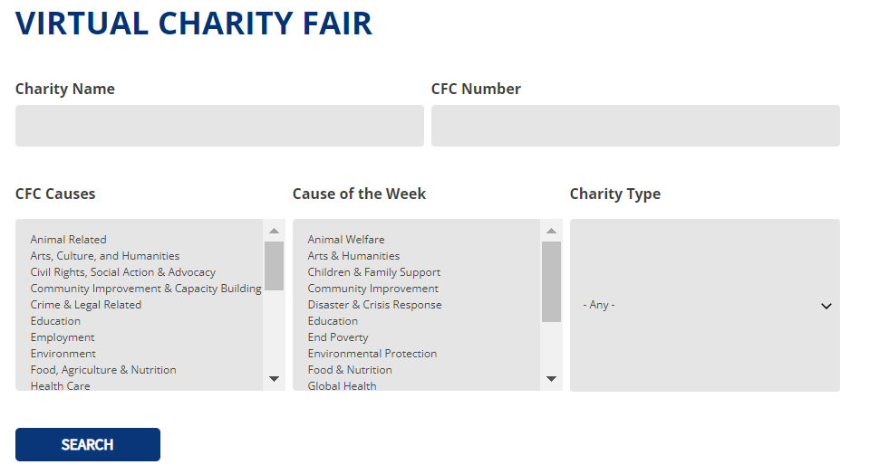
Virtual Charity Fair
Notes:
The next page on the website for our Virtual Charity Fair. The CFC asks charities to submit a written story and photo about someone they have helped and/or submit a 60-second video about the work they do. Not EVERY charity submits to the Virtual Charity Fair, but hundreds of them will. Reading those stories and watching those videos can be VERY inspiring. You can use these resources in your own communications and events. Or just promote the fair in general with your coworkers. You can see here that you can use these filters to help you narrow down the results.

Slide 33
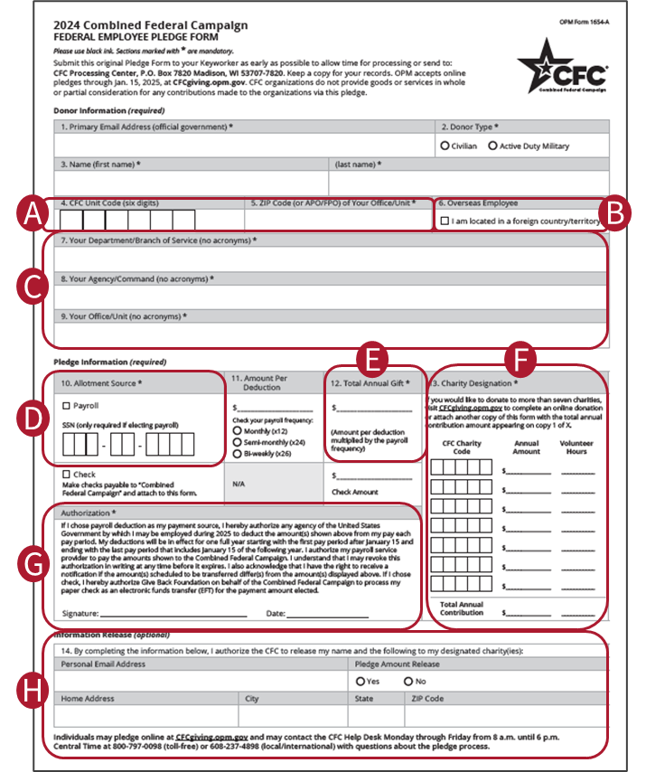
Handling Paper Pledge Forms
Review any paper pledges for accuracy. This prevents processing delays.
Make sure the donor kept a copy.
Download the “Pledge Summary” form and complete it.
Mail the summary and the pledge forms to the processing center.
Notes:
The next link on the website is a page to walk you though handling paper pledge forms. Paper pledging has been decline overall as more donors use the online giving system, but you may still receive paper pledges from donors, especially if you work in an area where employees don’t sit at a computer like USPS, DoD, TSA, etc. It is very helpful that you review the forms you receive for accuracy before you mail them in. This prevents processing errors. Make sure the donor kept a copy of the form for their own records. Download the pledge summary form and fill it out and then put the Summary sheet and the forms you collected into an envelope and mail it to the CFC pledge processing center. Please keep in mind that these forms contain PII and should be handled accordingly. For example, keep them in a locked area until you are ready to send them.

Slide 34
Awards
Notes:
[Local zones should update this slide with their own awards information]
We do offer some awards to recognize your excellent work and the success of the CFC in your agency/office/installation.

Slide 35
Campaign Close-Out Activities
Submit Final Paper Pledge Forms
Report to Leadership
Awards and Recognition
Continuity
Feedback
Notes:
Ok. That’s our walkthrough of the website. I am going to leave you with a brief summary of the activities we will be asking you to undertake at the end of the campaign. That is a long way from now, as the final day to pledge online will be January 15, 2025! So, we will be sending you reminders of these activities as we get closer to this time. But, once the campaign comes to a close, we will want you to round up and submit any remaining paper pledge forms from your co-workers. Then, report your final totals to your leadership so they can promote that in thank you messages (which are also available in the toolkit). You might be able to plan an awards and recognition event or participate in one being held virtually. It is VERY HELPFUL if you can leave some continuity material/binder for the campaign manager or keyworker who will replace you. You might even talk with your leadership about selecting your replacement at the end of this year’s campaign so that you can do turnover and offer guidance to them while the campaign is still fresh in your mind. And finally, we will be asking you to participate in some feedback opportunities and after-action review sessions to help us make the campaign better.

Slide 36




STAY CONNECTED!
[Facebook.com/localCFC]
[Twitter.com/localCFC]
[Instagram.com/localCFC]
[LinkedIn.com/localCFC]
Notes:
Wow! We made it. I know I’ve thrown a lot at you today, but hopefully I’ve also shown you where to go for resources and help. You can also contact us….

Slide 37
Questions?
Notes:
Now, are there any questions I can answer?

