Slide 1
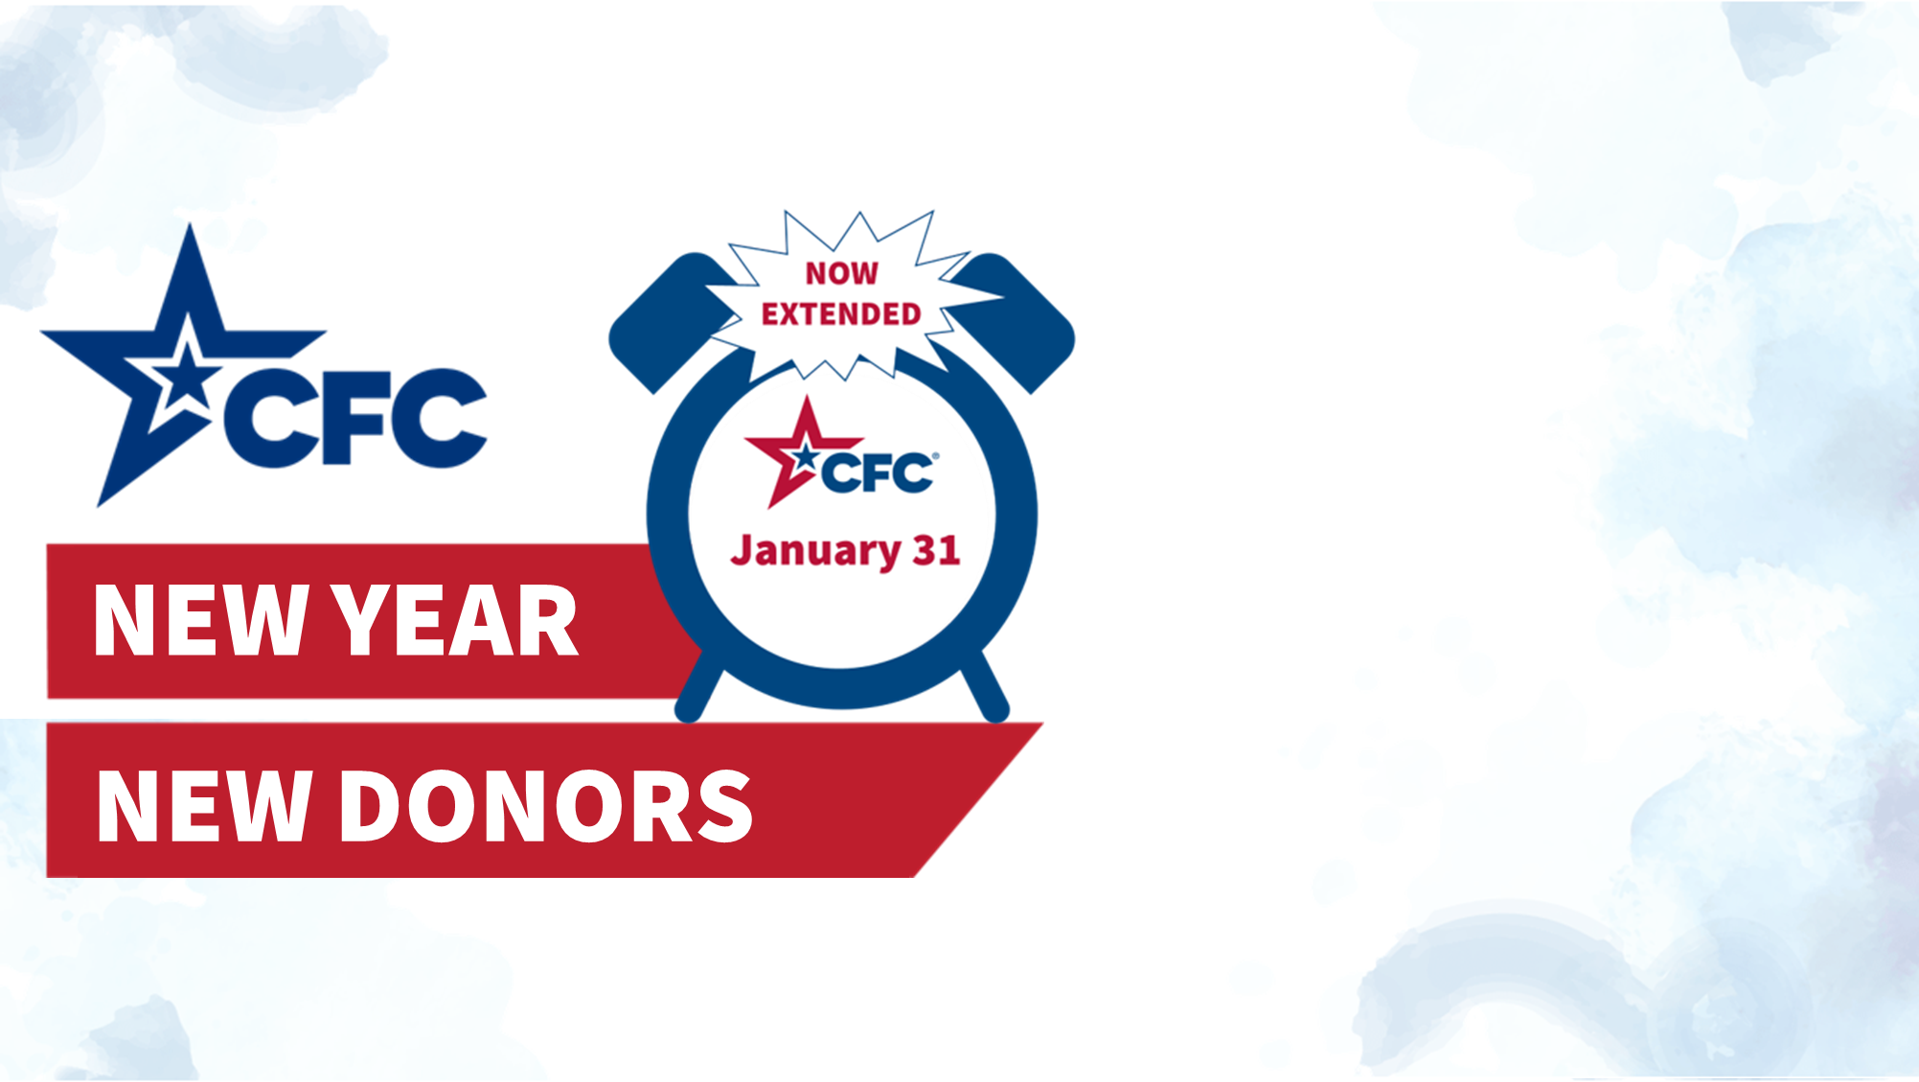
Introducing a weekly challenge in January!
Reach any of the milestones, to unlock a downloadable gift!
$1,000,000 in donations
1,000 new donors
1,000 volunteer hours
Follow along on GiveCFC.org.
Notes:
The Combined Federal Campaign (CFC) has been extended through the end of January! This is excellent news as it gives us a little more time to make a pledge this year. And the charities REALLY need our help, now more than ever. So much has been pledged to date. We want to keep this momentum going through January - so, the CFC is implementing a fun challenge. If we (the federal community) hit any of the milestones each week ($1M in donations, 1,000 new donors or 1,000 volunteer hours pledged), we will unlock a new downloadable gift. The first one is already released. It is a Weekly Planner Sheet with messages of gratitude and examples of what your donations can do from the CFC-participating charities. These sheets are great ways to stay organized and inspired each week. I can’t wait to see what’s next! You can follow along on GiveCFC.org for updates and keep an eye on your email box as I will be sending weekly messages with the links to download the new pages and keep you updated on campaign progress.

