Slide 1
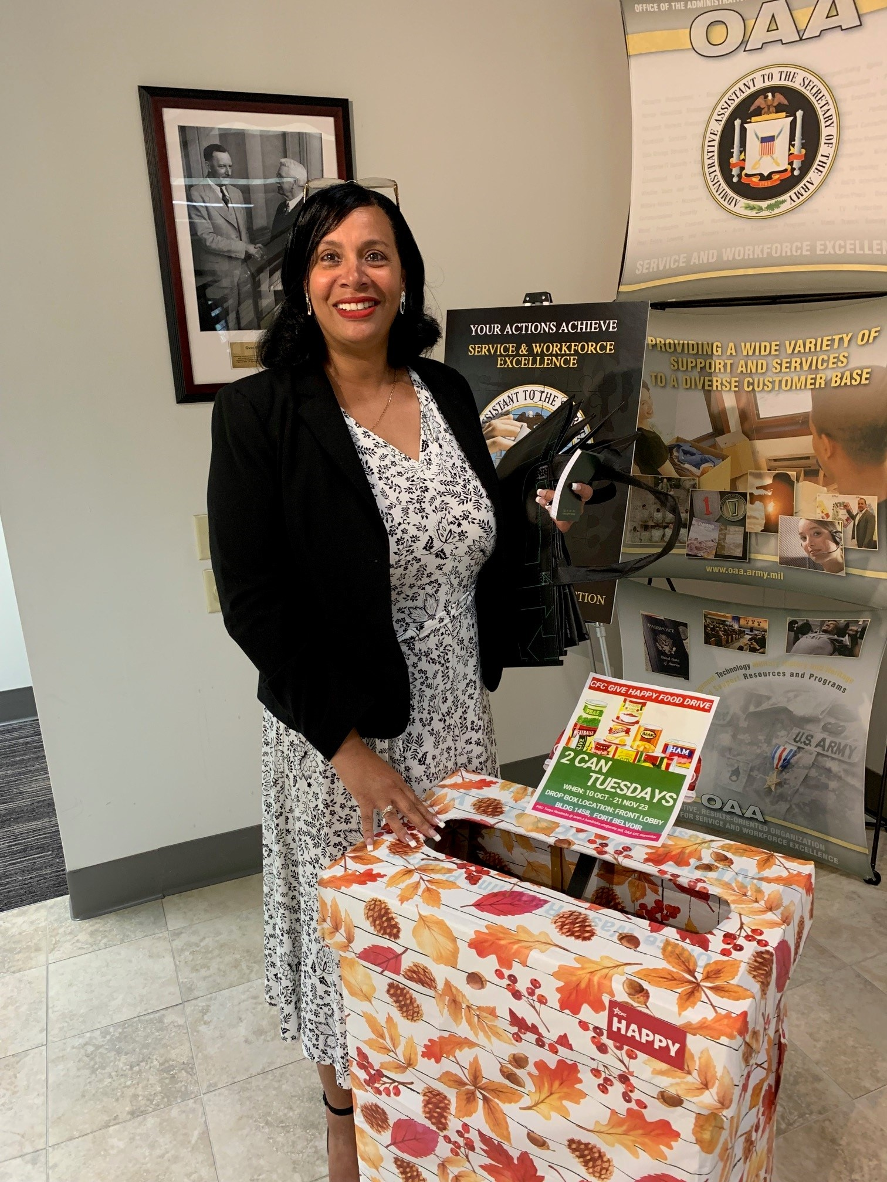
CFC 2024 Army, Mid-Atlantic
Two Cans Tuesday, Special Event
CFC 2024 Food Drive; CAUSE AREA: FOOD & NUTRITION
CFC Two Can Tuesday; Fisher House as Beneficiary: During the 2024 CFC Campaign, Office of the Administrative to the Secretary of the Army (OAA) Keyworker Tanya Hendricks, ITMO, spearheaded a can food drive to benefit the Army Fisher House at Fort Belvoir. This charitable institution offers a home away from home at no cost for families of patients receiving medical care at a military treatment facility, in this case the Fort Belvoir Hospital. They needed help to restock their community kitchen. Due to the generosity of workers in Bldg. 1458 and the Pentagon we delivered 210 cans and twelve pantry items. Program Manager, Campaign Managers and carrier Frank Jackson insured all can were delivered safely from Pentagon to Fort Belvoir, Army Fisher House for families in need.

Slide 2
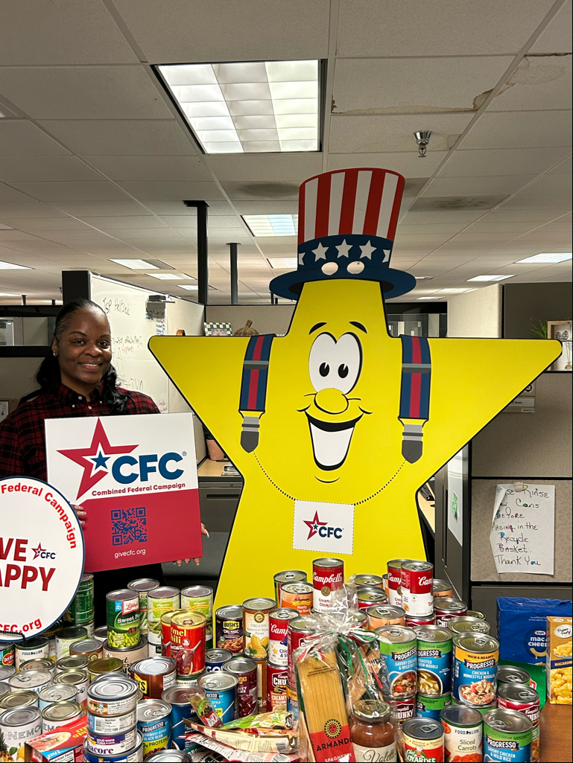
CFC 2024 Army, Mid-Atlantic
Two Cans Tuesday, Special Event
CFC 2024 Food Drive; CAUSE AREA: FOOD & NUTRITION

Slide 3
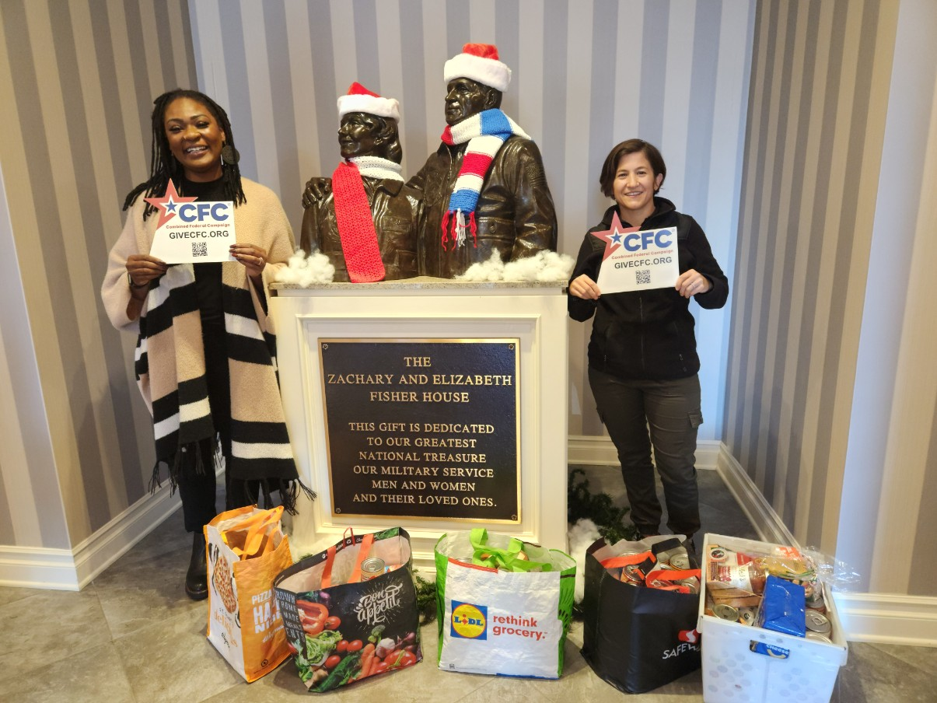
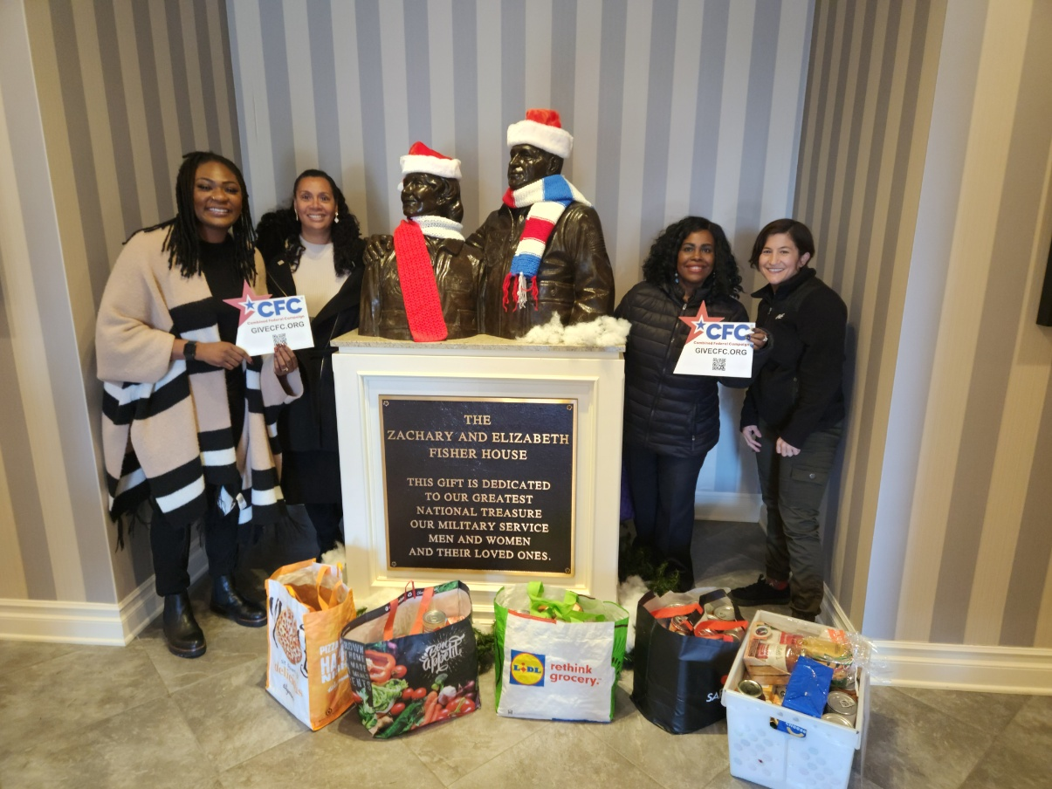
CFC 2024 Army, Mid-Atlantic
Two Cans Tuesday, Special Event
CFC 2024 Food Drive; CAUSE AREA: FOOD & NUTRITION

Slide 4
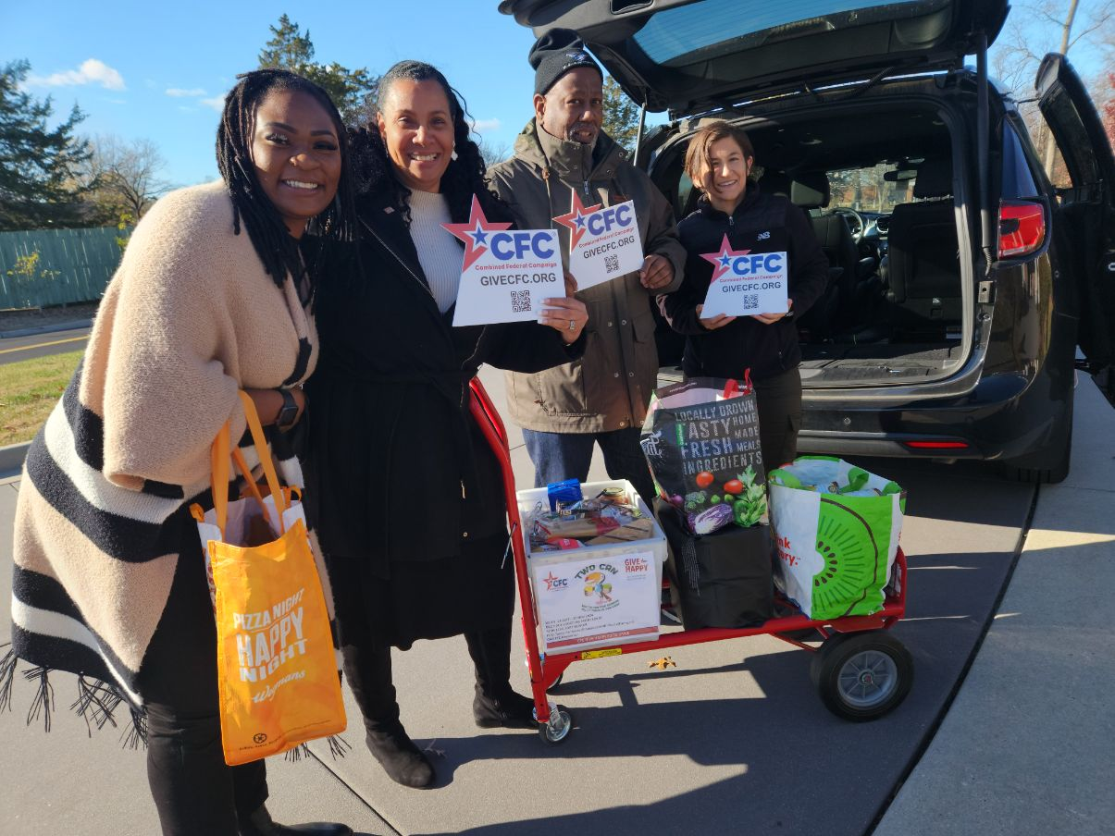
CFC 2024 Army, Mid-Atlantic
Two Cans Tuesday, Special Event
CFC 2024 Food Drive; CAUSE AREA: FOOD & NUTRITION

Slide 5
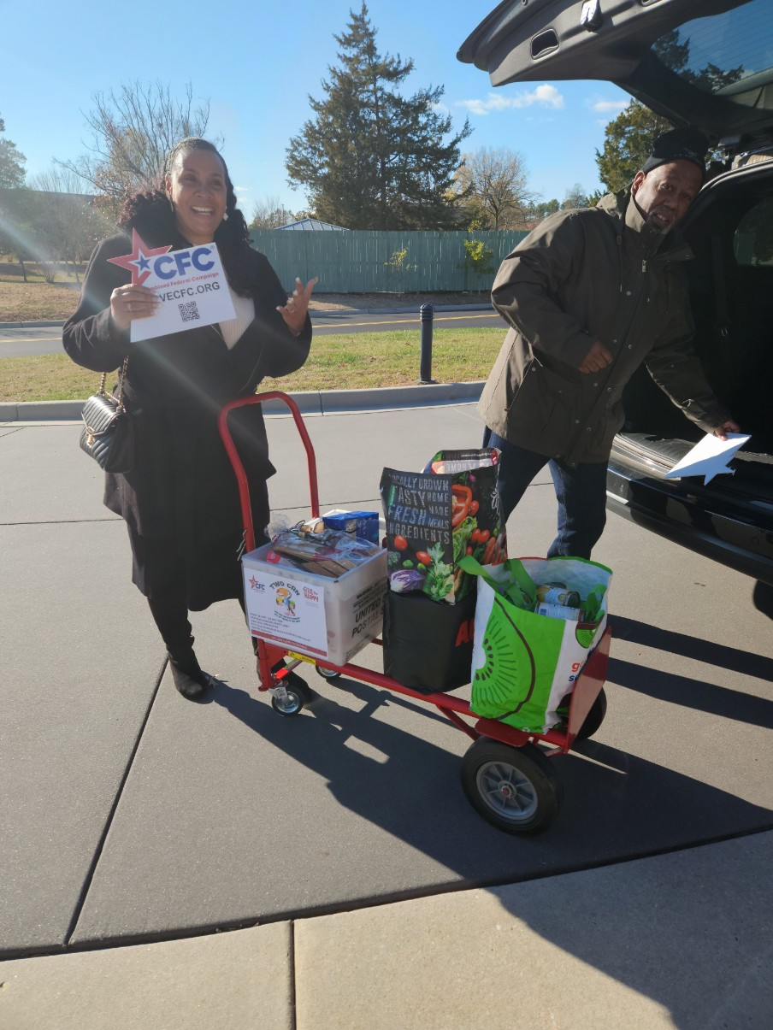
CFC 2024 Army, Mid-Atlantic,
Two Cans Tuesday, Special Event
CFC 2024 Food Drive; CAUSE AREA: FOOD & NUTRITION

